Slide 1
Role of LLMs in Education
By:
Saipraneeth Konuri

Slide 2
Introduction
Evolution of AI has transformed multiple sectors, especially education. LLMs like OpenAI's GPT series are at the forefront of this educational revolution. AI has shifted from basic adaptive content to interactive, real-time personalized learning.
Educational data mining, using predictive analytics and clustering, customizes student learning paths. LLMs are revolutionizing education by generating and interpreting complex texts.
Capabilities extend beyond linguistic tasks, facilitating knowledge integration across disciplines. LLMs enhance personalized education by adjusting content to the student's learning trajectory.

Slide 3
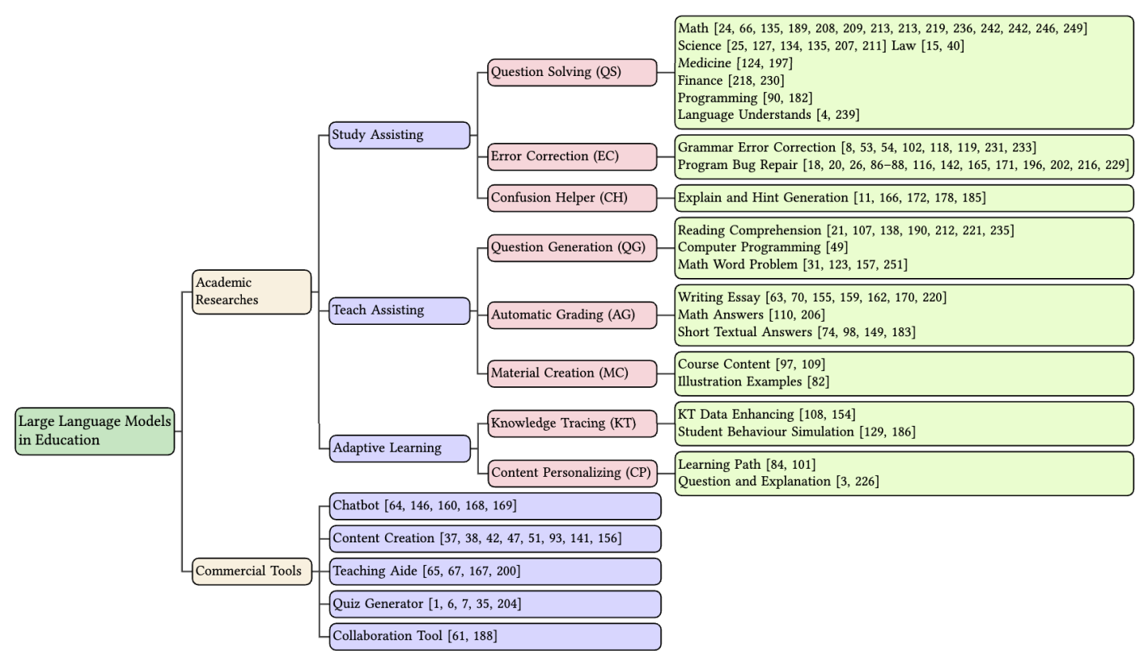
A taxonomy of LLMs for education applications with representative works

Slide 4
Applications of LLM in Education
Study Assistance with LLMs
Solving complex academic problems across various subjects.
Error correction and providing real-time feedback.
Confusion assistance with explanations and hints.
Teaching Assistance via LLMs
Generating educational materials and assessment questions.
Automating the grading process for written assignments.
Material creation from lecture notes to interactive modules.

Slide 5
Applications of LLM in Education
LLMs in Adaptive Learning
Personalizing learning paths with knowledge tracing.
Tailoring content to individual learning styles and needs.
Implementing LLMs in learning management systems for real-time adaptability.
LLMs as an Educational Toolkit
LLMs functioning as interactive chatbots for learner engagement.
Creating a wide range of digital educational content.
Providing tools for collaboration and enhanced learning experiences.

Slide 6
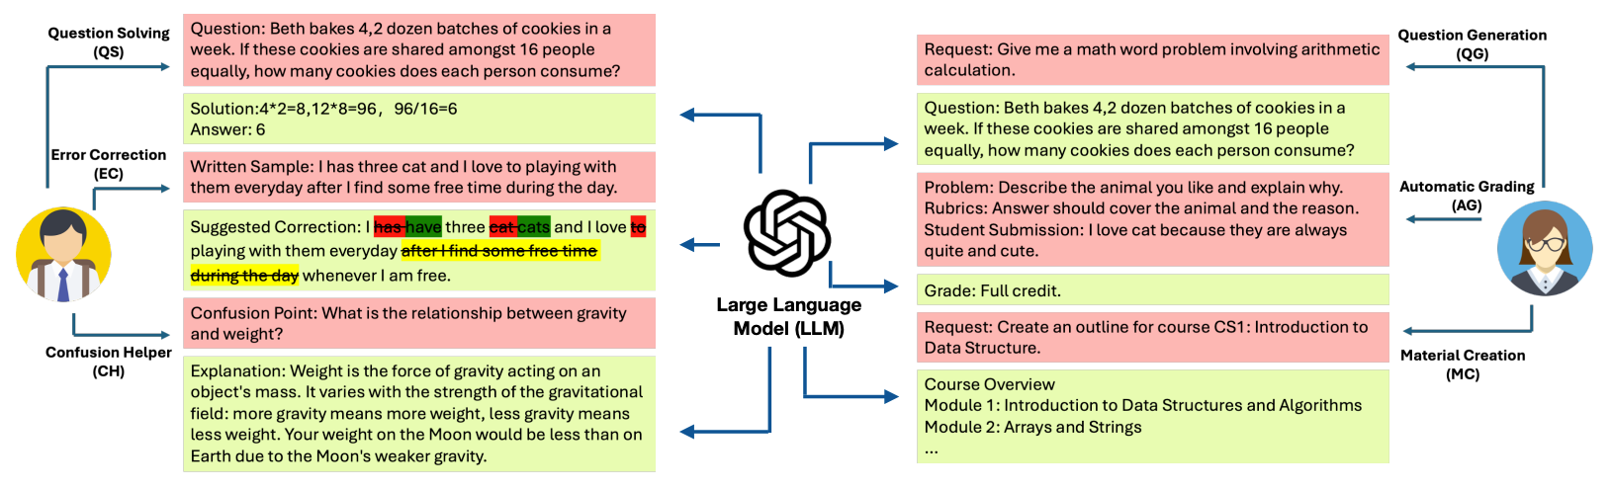
LLMs in student and teacher assisting

Slide 7
Dataset and Benchmark
We need to understand the importance and role of diverse datasets in developing capable LLMs.
Make use of benchmarks to measure and improve LLM performance.
Significance of text-rich educational tasks in LLM training.
Diverse datasets train LLMs, while benchmarks measure effectiveness in educational tasks.
Datasets include student performance, pedagogical texts, and subject-specific resources.
Benchmarks assess LLM accuracy in problem-solving, content quality, and personalization.

Slide 8
Technologies and Methodologies Employed by LLMs in Education
Fine-Tuning on Educational Data
Adaptive Learning Algorithms
Automated Content Generation
Natural Language Understanding and Processing
Real-Time Feedback and Interaction
Integration with Educational Platforms
Multimodal Learning Support

Slide 9
Risks and Challenges
The integration of LLMs into education presents challenges that need ethical consideration.
Addressing inherent biases in AI to promote fairness and inclusiveness.
Balancing the use of technology with critical thinking development to avoid overdependence.
Addressing bias to ensure fairness and inclusiveness.
Ensuring reliability and safety in educational content.
Balancing technology use with the development of critical thinking.

Slide 10
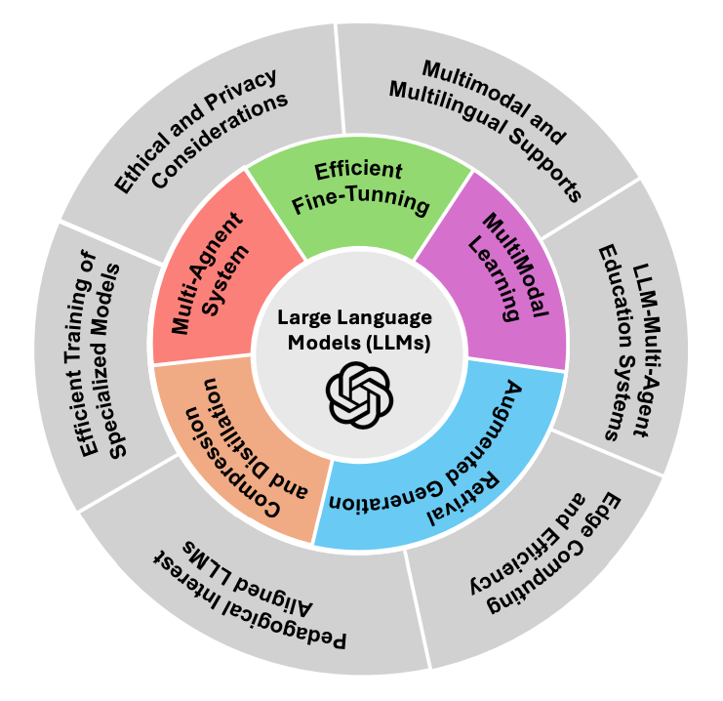
Future directions for LLMs in education

Slide 11
Conclusion
LLMs have the potential to redefine educational methodologies.
Future developments promise more specialized and efficient LLM applications.
The importance of ethical and inclusive technology integration.
LLMs are a transformative force in education, poised to redefine teaching and learning.
Continuous innovation is key to unlocking the full potential of LLMs in education.
Ethical integration and inclusive technology will ensure LLMs benefit all educational stakeholders.

Slide 12
Thank You

